Slide 1
Owl M-A Material Design Study App
Antony K Nayakam -715522104004
Ganesh Balaji V - 715522104019
Hema Veeratta Moorthy
Thiruathigai L - 715522104023
Siddiq M - 715522104306

Slide 2
DESCRIPTION
Owl M-A Material Design Study App is a modern educational tool designed to revolutionize the learning experience by leveraging the principles of Material Design for a sleek and intuitive interface. This app serves as a comprehensive platform for students and educators to organize, access, and interact with study materials seamlessly. With features such as personalized advanced material organization and engaging study environment. Owl M supports offline access, cross-platform compatibility, and gamified learning to keep users motivated and on track. Its combination of aesthetics and functionality makes it the perfect companion for anyone looking to enhance their academic or self-learning journey.

Slide 3
ContentDialog.kt:
package com.example.owlapplication
import androidx.compose.foundation.background
import androidx.compose.foundation.layout.*
import androidx.compose.foundation.text.BasicTextField
import androidx.compose.material.*
import androidx.compose.runtime.*
import androidx.compose.ui.Alignment
import androidx.compose.ui.Modifier
import androidx.compose.ui.graphics.Color
import androidx.compose.ui.text.input.ImeAction
import androidx.compose.foundation.text.KeyboardOptions
import androidx.compose.ui.unit.dp
@Composable
fun AddContentDialog(onDismiss: () -> Unit, onConfirm: (String) -> Unit) {
var newContent by remember { mutableStateOf("") }
AlertDialog(
onDismissRequest = onDismiss,
title = { Text("Add New Content") },
text = {

Slide 4
Column {
BasicTextField(
value = newContent,
onValueChange = { newContent = it },
keyboardOptions = KeyboardOptions.Default.copy(
imeAction = ImeAction.Done
),
modifier = Modifier
.fillMaxWidth()
.padding(8.dp),
singleLine = false
)
}
},
confirmButton = {
TextButton(
onClick = {
onConfirm(newContent) // Pass the new content
onDismiss() // Close the dialog
}
) {
Text("Confirm", color = Color.Green)
}
},

Slide 5
dismissButton = {
TextButton(onClick = onDismiss) {
Text("Cancel", color = Color.Red)
}
},
backgroundColor = Color.White,
contentColor = Color.Black
)
}

Slide 6
LoginActivity.kt
package com.example.owlapplication
import android.content.Context
import android.content.Intent
import android.os.Bundle
import androidx.activity.ComponentActivity
import androidx.activity.compose.setContent
import androidx.compose.foundation.Image
import androidx.compose.foundation.background
import androidx.compose.foundation.layout.*
import androidx.compose.material.*
import androidx.compose.runtime.*
import androidx.compose.ui.Alignment
import androidx.compose.ui.Modifier
import androidx.compose.ui.graphics.Brush
import androidx.compose.ui.graphics.Color
import androidx.compose.ui.layout.ContentScale
import androidx.compose.ui.res.painterResource
import androidx.compose.ui.text.font.FontFamily
import androidx.compose.ui.text.font.FontWeight
import androidx.compose.ui.text.input.PasswordVisualTransformation
import androidx.compose.ui.tooling.preview.Preview
import androidx.compose.ui.unit.dp

Slide 7
import androidx.compose.ui.unit.sp
import androidx.compose.ui.platform.LocalContext
import androidx.core.content.ContextCompat
import com.example.owlapplication.ui.theme.OwlApplicationTheme
import androidx.compose.material.icons.Icons
import androidx.compose.material.icons.filled.Person
import androidx.compose.material.icons.filled.Lock
class LoginActivity : ComponentActivity() {
private lateinit var databaseHelper: UserDatabaseHelper
override fun onCreate(savedInstanceState: Bundle?) {
super.onCreate(savedInstanceState)
databaseHelper = UserDatabaseHelper(this)
setContent {
LoginScreen(this, databaseHelper)
}
}
}
@Composable
fun LoginScreen(context: Context, databaseHelper: UserDatabaseHelper) {
var username by remember { mutableStateOf("") }
var password by remember { mutableStateOf("") }
var error by remember { mutableStateOf("") }

Slide 8
Column(
modifier = Modifier
.fillMaxSize()
.background(
brush = Brush.verticalGradient(
colors = listOf(Color(0xFF2996EC), Color(0xFF3ADF34))
)
),
horizontalAlignment = Alignment.CenterHorizontally,
verticalArrangement = Arrangement.Center
) {
// App Icon or Illustration
Image(
painter = painterResource(id = R.drawable.study_login),
contentDescription = "",
modifier = Modifier.size(150.dp),
contentScale =

Slide 9
ContentScale.Fit
)
// App Title
Text(
text = "Welcome Back!",
fontSize = 32.sp,
fontWeight = FontWeight.Bold,
color = Color.White,
modifier = Modifier.padding(top = 16.dp)
)
Spacer(modifier = Modifier.height(16.dp))
// Username TextField
OutlinedTextField(
value = username,
onValueChange = { username = it },
label = { Text("Username", color = Color.White) },
leadingIcon = { Icon(Icons.Filled.Person,

Slide 10
contentDescription = null) },
colors = TextFieldDefaults.outlinedTextFieldColors(focusedBorderColor = Color.White),
modifier = Modifier
.padding(10.dp)
.width(280.dp)
)
// Password TextField
OutlinedTextField(
value = password,
onValueChange = { password = it },
label = { Text("Password", color = Color.White) },
leadingIcon = { Icon(Icons.Filled.Lock, contentDescription = null) },
visualTransformation = PasswordVisualTransformation(),
colors = TextFieldDefaults.outlinedTextFieldColors(focusedBorderColor =

Slide 11
Color.White),
modifier = Modifier
.padding(10.dp)
.width(280.dp)
)
// Error Message Display
if (error.isNotEmpty()) {
Text(
text = error,
color = Color(0xFFF44336),
modifier = Modifier.padding(vertical = 16.dp)
)
}
// Login Button
Button(
onClick = {
if (username.isNotEmpty() && password.isNotEmpty()) {
val user = databaseHelper.getUserByUsername(username)
if (user != null &&

Slide 12
user.password == password) {
error = "Log In Successful" context.startActivity(Intent(context, MainActivity::class.java))
} else {
error = "Invalid username or password"
}
} else {
error = "Please fill all fields"
}
},
modifier = Modifier
.padding(top = 16.dp)
.width(280.dp)
.height(50.dp),
colors = ButtonDefaults.buttonColors(backgroundColor = Color(0xFF4CAF50))
) {
Text(text = "Login", color = Color.White, fontSize = 18.sp) }

Slide 13
// Register & Forget Password Links
Row(
modifier = Modifier.padding(top = 16.dp),
horizontalArrangement = Arrangement.SpaceBetween
) {
TextButton(onClick = {
context.startActivity(Intent(context, RegisterActivity::class.java))
}) {
Text(text = "Register", color = Color.White)
}
Spacer(modifier = Modifier.width(20.dp))
TextButton(onClick = {
// Handle Forget Password
}) {
Text(text = "Forget password?", color = Color.White)
}

Slide 14
}
}
}
private fun startMainPage(context: Context) {
val intent = Intent(context, MainActivity::class.java)
ContextCompat.startActivity(context, intent, null)
}
@Preview(showBackground = true)
@Composable
fun PreviewLoginScreen() {
OwlApplicationTheme {
LoginScreen(context = LocalContext.current, databaseHelper = UserDatabaseHelper(LocalContext.current))
}
}

Slide 15
MainActivity.kt
package com.example.owlapplication
import android.content.Context
import android.content.Intent
import android.os.Bundle
import androidx.activity.ComponentActivity
import androidx.activity.compose.setContent
import androidx.compose.foundation.Image
import androidx.compose.foundation.background
import androidx.compose.foundation.clickable
import androidx.compose.foundation.layout.*
import androidx.compose.foundation.rememberScrollState
import androidx.compose.foundation.shape.Rou

Slide 16
ndedCornerShape
import androidx.compose.foundation.verticalScroll
import androidx.compose.material.Card
import androidx.compose.material.Text
import androidx.compose.runtime.Composable
import androidx.compose.ui.Alignment
import androidx.compose.ui.Modifier
import androidx.compose.ui.draw.clip
import androidx.compose.ui.draw.scale
import androidx.compose.ui.graphics.Color
import androidx.compose.ui.res.painterReso
import androidx.compose.ui.res.stringResour

Slide 17
import androidx.compose.ui.text.font.Font
import androidx.compose.ui.text.font.FontWeight
import androidx.compose.ui.text.style.TextAlign
import androidx.compose.ui.unit.dp
import androidx.compose.ui.unit.sp
// Define a color palette
val primaryColor = Color(0xFF2196F3) // Vibrant blue
val secondaryColor = Color(0x9DD9FAFF) // Light gray
val accentColor = Color(0xFFE91E63) // Pink accent
class MainActivity : ComponentActivity() {
override fun onCreate(savedInstanceState: Bundle?) {

Slide 18
super.onCreate(savedInstanceState)
setContent {
StudyApp(this)
}
}
}
@Composable
fun StudyApp(context: Context) {
Column(
modifier = Modifier
.padding(20.dp)
.fillMaxSize()
.background(secondaryColor) // Light gray background
.verticalScroll(rememberScrollState())
) {
Text(
text = "Study Material",
fontSize = 36.sp,
fontWeight = FontWeight.Bold,

Slide 19
color = primaryColor, // Vibrant blue
modifier = Modifier.align(Alignment.CenterHorizontally)
)
Spacer(modifier = Modifier.height(20.dp))
// Create a list of card data
val cardData = listOf(
CardData(
imageId = R.drawable.img_1,
courseTitle = stringResource(id = R.string.course1),
topicTitle = stringResource(id = R.string.topic1),
targetActivity = MainActivity2::class.java
),
CardData(
imageId = R.drawable.img_2,
courseTitle =

Slide 20
stringResource(id = R.string.course2),
topicTitle = stringResource(id = R.string.topic2),
targetActivity = MainActivity3::class.java
),
CardData(
imageId = R.drawable.img_3,
courseTitle = stringResource(id = R.string.course3),
topicTitle = stringResource(id = R.string.topic3),
targetActivity = MainActivity4::class.java
),
CardData(
imageId = R.drawable.img_4,
courseTitle = stringResource(id = R.string.course4), // Assuming typo
topicTitle = stringResource(id = R.string.topic4),
targetActivity =

Slide 21
MainActivity5::class.java
)
)
// Loop through the card data and create cards
cardData.forEach { card ->
Card(
modifier = Modifier
.fillMaxWidth()
.height(250.dp)
.clickable {
context.startActivity(Intent(context, card.targetActivity))
}
.clip(RoundedCornerShape(16.dp)), // Rounded corners
elevation = 8.dp,
backgroundColor = secondaryColor // White card background
) {
Column(
horizontalAlignment =

Slide 22
Alignment.CenterHorizontally,
modifier = Modifier.background(secondaryColor) // Light gray background for card content
) {
Image(
painterResource(id = card.imageId),
contentDescription = "",
modifier = Modifier
.height(150.dp)
.scale(scaleX = 1.2F, scaleY = 1F)
)
Text(
text = card.courseTitle,
color = primaryColor, // Vibrant blue
fontSize = 16.sp,
// Use a custom font if desired (replace with your font file)

Slide 23
// font = Font(resource = "your_font_file.ttf")
)
Text(
text = card.topicTitle,
fontWeight = FontWeight.Bold,
fontSize = 20.sp,
textAlign = TextAlign.Center,
// Use a custom font if desired (replace with your font file)
// font = Font(resource = "your_font_file.ttf")
)
}
}
Spacer(modifier = Modifier.height(20.dp))
}
}
}
// Data class to hold card information
data class CardData(

Slide 24
val imageId: Int,
val courseTitle: String,
val topicTitle: String,
val targetActivity: Class<out ComponentActivity>

Slide 25
MainActivity2.kt
package com.example.owlapplication
import android.content.Context
import android.content.SharedPreferences
import android.os.Bundle
import androidx.activity.ComponentActivity
import androidx.activity.compose.setContent
import androidx.compose.foundation.Image
import androidx.compose.foundation.background
import androidx.compose.foundation.clickable
import androidx.compose.foundation.layout.*
import androidx.compose.foundation.rememberScrollState
import c

Slide 26
androidx.compose.foundation.shape.CircleShape
import androidx.compose.foundation.text.BasicTextField
import androidx.compose.foundation.verticalScroll
import androidx.compose.material.*
import androidx.compose.material.icons.Icon
import androidx.compose.material.icons.filled.Add
import androidx.compose.runtime.*
import androidx.compose.ui.Alignment
import androidx.compose.ui.Modifier
import androidx.compose.ui.draw.scale
import androidx.compose.ui.graphics.Color
import androidx.compose.ui.res.painterResou

Slide 27
import androidx.compose.ui.res.stringResource
import androidx.compose.ui.text.font.FontWeight
import androidx.compose.ui.text.style.TextAlign
import androidx.compose.ui.unit.dp
import androidx.compose.ui.unit.sp
import com.example.owlapplication.ui.theme.OwlApplicationTheme
class MainActivity2 : ComponentActivity() {
private lateinit var sharedPreferences: SharedPreferences
override fun onCreate(savedInstanceState: Bundle?) {

Slide 28
super.onCreate(savedInstanceState)
sharedPreferences = getSharedPreferences("AppPreferences", Context.MODE_PRIVATE)
setContent {
OwlApplicationTheme {
Greeting(sharedPreferences)
}
}
}
}
@Composable
fun Greeting(sharedPreferences: SharedPreferences) {
var showDialog by remember { mutableStateOf(false) }
var additionalContent by remember { mutableStateOf(loadContent(sharedPreferences)) }

Slide 29
if (showDialog) {
AddContentDialog2(
onDismiss = { showDialog = false },
onConfirm = { newText ->
additionalContent += "\n$newText"
saveContent(sharedPreferences, additionalContent)
showDialog = false
}
)
}
Box(
modifier = Modifier
.padding(26.dp)
.verticalScroll(rememberScrollState())
.background(Color.White)
) {
Column(
modifier =

Slide 30
Modifier.fillMaxWidth(),
verticalArrangement = Arrangement.Top
) {
Image(
painter = painterResource(id = R.drawable.img_1),
contentDescription = "",
modifier = Modifier.scale(1.5f)
)
Spacer(modifier = Modifier.height(60.dp))
Text(
text = stringResource(id = R.string.course1),
color = Color(0xFFB2F436),
fontSize = 20.sp,
modifier = Modifier.align(Alignment.CenterHorizontally)
)

Slide 31
Spacer(modifier = Modifier.height(20.dp))
Text(
text = stringResource(id = R.string.topic1),
fontWeight = FontWeight.Bold,
fontSize = 26.sp,
modifier = Modifier.align(Alignment.CenterHorizontally)
)
Spacer(modifier = Modifier.height(20.dp))
Text(
text = stringResource(id = R.string.subheading1_1),
modifier = Modifier.align(Alignment.Start),
fontSize = 20.sp
)
Spacer(modifier =

Slide 32
Modifier.height(20.dp))
Text(
text = stringResource(id = R.string.text1_1),
modifier = Modifier.align(Alignment.Start),
textAlign = TextAlign.Justify,
fontSize = 16.sp
)
Spacer(modifier = Modifier.height(20.dp))
if (additionalContent.isNotEmpty()) {
Text(
text = additionalContent,
modifier = Modifier.align(Alignment.Start),
textAlign = TextAlign.Justify,
fontSize = 16.sp,
)

Slide 33
}
}
// Cyan icon at the top-right corner
Icon(
imageVector = Icons.Default.Add,
contentDescription = "Add Content",
tint = Color.White,
modifier = Modifier
.size(32.dp)
.background(Color.Cyan, shape = CircleShape)
.align(Alignment.TopEnd) // Align to top-end (top-right corner)
.padding(4.dp)
.clickable {
showDialog = true
}
)
}
}

Slide 34
fun saveContent(sharedPreferences: SharedPreferences, content: String) {
with(sharedPreferences.edit()) {
putString("additional_content", content)
apply()
}
}
fun loadContent(sharedPreferences: SharedPreferences): String {
return sharedPreferences.getString("additional_content", "") ?: ""
}
@Composable
fun AddContentDialog2(
onDismiss: () -> Unit,
onConfirm: (String) -> Unit
) {
var newText by remember { mutableStateOf("") }

Slide 35
AlertDialog(
onDismissRequest = { onDismiss() },
title = { Text(text = "Add New Content") },
text = {
Column {
Text("Enter new content below:")
Spacer(modifier = Modifier.height(8.dp))
BasicTextField(
value = newText,
onValueChange = { newTextValue -> newText = newTextValue },
modifier = Modifier
.background(Color.LightGray, shape = CircleShape)
.padding(8.dp)
.fillMaxWidth()
)
}
},

Slide 36
confirmButton = {
Button(
onClick = { onConfirm(newText) }
) {
Text("Confirm")
}
},
dismissButton = {
Button(onClick = onDismiss) {
Text("Cancel")
}
}
)
}

Slide 37
MainActivity3.kt
import android.os.Bundle
import androidx.activity.ComponentActivity
import androidx.activity.compose.setContent
import androidx.compose.foundation.Image
import androidx.compose.foundation.background
import androidx.compose.foundation.clickabl
import androidx.compose.foundation.layout.*
import androidx.compose.foundation.rememberScrollState
import androidx.compose.foundation.shape.CircleShape
import androidx.compose.foundation.text.BasicTextField

Slide 38
import androidx.compose.foundation.verticalScroll
import androidx.compose.material.*
import androidx.compose.material.icons.Icons
import androidx.compose.material.icons.filled.Add
import androidx.compose.runtime.*
import androidx.compose.ui.Alignment
import androidx.compose.ui.Modifier
import androidx.compose.ui.draw.scale
import androidx.compose.ui.graphics.Color
import androidx.compose.ui.res.painterResource
import androidx.compose.ui.res.stringResource
import

Slide 39
androidx.compose.ui.text.font.FontWeight
import androidx.compose.ui.text.style.TextAlign
import androidx.compose.ui.unit.dp
import androidx.compose.ui.unit.sp
class MainActivity3 : ComponentActivity() {
override fun onCreate(savedInstanceState: Bundle?) {
super.onCreate(savedInstanceState)
setContent {
Greeting1()
}
}
}
@Composable
fun Greeting1() {
var showDialog by remember { mutableStateOf(false) }

Slide 40
var additionalContent by remember { mutableStateOf("") }
if (showDialog) {
AddContentDialog3(
onDismiss = { showDialog = false },
onConfirm = { newText ->
additionalContent += "\n$newText" // Append new content
showDialog = false
}
)
}
Column(
modifier = Modifier
.padding(start = 26.dp, end = 26.dp, bottom = 26.dp, top = 26.dp)
.verticalScroll(rememberScrollState())
.background(Color.White),
verticalArrangement = Arrangement.Top
) {

Slide 41
Box {
Image(
painter = painterResource(id = R.drawable.img_2),
contentDescription = "",
modifier = Modifier
//.align(Alignment.CenterHorizontally) .scale(scaleX = 1.2F, scaleY = 1F)
)
Icon(
imageVector = Icons.Default.Add,
contentDescription = "Add Content",
tint = Color.White,
modifier = Modifier
.size(32.dp)
.background(Color.Cyan, shape = CircleShape)
.align(Alignment.TopEnd)

Slide 42
.padding(4.dp)
.clickable {
showDialog = true
}
)
}
Spacer(modifier = Modifier.height(20.dp))
Text(
text = stringResource(id = R.string.course2),
color = Color(0xFFD71912),
fontSize = 20.sp,
modifier = Modifier.align(Alignment.CenterHorizontally)
)
Spacer(modifier = Modifier.height(20.dp))
Text(
text = stringResource(id =

Slide 43
R.string.topic2),
fontWeight = FontWeight.Bold,
fontSize = 26.sp,
modifier = Modifier.align(Alignment.CenterHorizontally)
)
Spacer(modifier = Modifier.height(20.dp))
Text(
text = stringResource(id = R.string.subheading2_1),
modifier = Modifier.align(Alignment.Start),
fontSize = 20.sp
)
Spacer(modifier = Modifier.height(20.dp))
Text(
text = stringResource(id =

Slide 44
R.string.text2_1),
modifier = Modifier.align(Alignment.Start),
textAlign = TextAlign.Justify,
fontSize = 16.sp
)
Spacer(modifier = Modifier.height(20.dp))
Text(
text = stringResource(id = R.string.subheading2_2),
modifier = Modifier.align(Alignment.Start),
fontSize = 20.sp
)
Spacer(modifier = Modifier.height(20.dp))
Text(
text = stringResource(id = R.string.text2_2),
modifier =

Slide 45
Modifier.align(Alignment.Start),
textAlign = TextAlign.Justify,
fontSize = 16.sp
)
Spacer(modifier = Modifier.height(20.dp))
// Display additional content if added
if (additionalContent.isNotEmpty()) {
Text(
text = additionalContent,
modifier = Modifier.align(Alignment.Start),
textAlign = TextAlign.Justify,
fontSize = 16.sp,
color = Color.Gray
)
}
}
}

Slide 46
@Composable
fun AddContentDialog3(
onDismiss: () -> Unit,
onConfirm: (String) -> Unit
) {
var newText by remember { mutableStateOf("") }
AlertDialog(
onDismissRequest = { onDismiss() },
title = { Text(text = "Add New Content") },
text = {
Column {
Text("Enter new content below:")
Spacer(modifier = Modifier.height(8.dp))
BasicTextField(
value = newText,
onValueChange = { newText = it },
modifier = Modifier
.background(Color.Lig

Slide 47
htGray, shape = CircleShape)
.padding(8.dp)
.fillMaxWidth()
)
}
},
confirmButton = {
Button(
onClick = {
onConfirm(newText)
}
) {
Text("Confirm")
}
},
dismissButton = {
Button(
onClick = { onDismiss() }
) {
Text("Cancel")
}
}
)
}

Slide 48
MainActivity4.kt
package com.example.owlapplication
import android.os.Bundle
import androidx.activity.ComponentActivity
import androidx.activity.compose.setContent
import androidx.compose.foundation.Image
import androidx.compose.foundation.background
import androidx.compose.foundation.layout.*
import androidx.compose.foundation.rememberScrollState
import androidx.compose.foundation.verticalScroll
import androidx.compose.material.MaterialTheme

Slide 49
import androidx.compose.material.Surface
import androidx.compose.material.Text
import androidx.compose.runtime.Composable
import androidx.compose.ui.Alignment
import androidx.compose.ui.Modifier
import androidx.compose.ui.draw.scale
import androidx.compose.ui.graphics.Color
import androidx.compose.ui.res.painterReso
import androidx.compose.ui.res.stringResource
import androidx.compose.ui.text.font.FontWeight
import androidx.compose.ui.text.style.TextA

Slide 50
import androidx.compose.ui.tooling.preview.Preview
import androidx.compose.ui.unit.dp
import androidx.compose.ui.unit.sp
import com.example.owlapplication.ui.theme.OwlApplicationTheme
class MainActivity4 : ComponentActivity() {
override fun onCreate(savedInstanceState: Bundle?) {
super.onCreate(savedInstanceState)
setContent {
Greeting2()
}
}
}
@Composable
fun Greeting2() {
Column(
modifier =

Slide 51
Modifier.padding(start = 26.dp, end = 26.dp, bottom = 26.dp, top = 26.dp)
.verticalScroll(rememberScrollState())
.background(Color.White),
verticalArrangement = Arrangement.Top
) {
Image(
painterResource(id = R.drawable.img_3),
contentDescription = "",
modifier = Modifier.align(Alignment.CenterHorizontally)
.scale(scaleX = 1.5F, scaleY = 2F)
)
Spacer(modifier = Modifier.height(60.dp))
Text(
text = stringResource(id =

Slide 52
R.string.course3),
color = Color(0xFFFFA500),
fontSize = 20.sp,
modifier = Modifier.align(Alignment.CenterHorizontally)
)
Spacer(modifier = Modifier.height(20.dp))
Text(
text = stringResource(id = R.string.topic3),
fontWeight = FontWeight.Bold,
fontSize = 26.sp,
modifier = Modifier.align(Alignment.CenterHorizontally)
)
Spacer(modifier = Modifier.height(20.dp))
Text(

Slide 53
text = stringResource(id = R.string.subheading3_1),
modifier = Modifier.align(Alignment.Start),
fontSize = 20.sp
)
Spacer(modifier = Modifier.height(20.dp))
Text(
text = stringResource(id = R.string.text3_1),
modifier = Modifier.align(Alignment.Start),
textAlign = TextAlign.Justify,
fontSize = 16.sp
)
Spacer(modifier = Modifier.height(20.dp))
Text(
text = stringResource(id = R.string.subheading3_2),
modifier =

Slide 54
Modifier.align(Alignment.Start),
fontSize = 20.sp
)
Spacer(modifier = Modifier.height(20.dp))
Text(
text = stringResource(id = R.string.text3_2),
modifier = Modifier.align(Alignment.Start),
textAlign = TextAlign.Justify,
fontSize = 16.sp
)
}
}

Slide 55
MainActivity5.kt
package com.example.owlapplication
import android.os.Bundle
import androidx.activity.ComponentActivity
import androidx.activity.compose.setContent
import androidx.compose.foundation.Image
import androidx.compose.foundation.background
import androidx.compose.foundation.layout.*
import androidx.compose.foundation.rememberScrollState
import androidx.compose.foundation.verticalScroll
import androidx.compose.material.MaterialT

Slide 56
import androidx.compose.material.Surface
import androidx.compose.material.Text
import androidx.compose.runtime.Composable
import androidx.compose.ui.Alignment
import androidx.compose.ui.Modifier
import androidx.compose.ui.draw.scale
import androidx.compose.ui.graphics.Color
import androidx.compose.ui.res.painterResource
import androidx.compose.ui.res.stringResour
import androidx.compose.ui.text.font.FontWeight
import androidx.compose.ui.text.style.Text

Slide 57
import androidx.compose.ui.tooling.preview.Preview
import androidx.compose.ui.unit.dp
import androidx.compose.ui.unit.sp
import com.example.owlapplication.ui.theme.OwlApplicationTheme
class MainActivity5 : ComponentActivity() {
override fun onCreate(savedInstanceState: Bundle?) { super.onCreate(savedInstanceState)
setContent {
Greeting3()
}
}
}
@Composable
fun Greeting3() {
Column(
modifier =

Slide 58
Modifier.padding(start = 26.dp, end = 26.dp, bottom = 26.dp, top = 26.dp)
.verticalScroll(rememberScrollState())
.background(Color.White),
verticalArrangement = Arrangement.Top
) {
Image(
painterResource(id = R.drawable.img_4),
contentDescription = "",
modifier = Modifier.align(Alignment.CenterHorizontally)
.scale(scaleX = 1.5F, scaleY = 1.5F)
)
Spacer(modifier = Modifier.height(60.dp))
Text(
text = stringResource(id =

Slide 59
R.string.course4),
color = Color(0xF4511EFF),
fontSize = 20.sp,
modifier = Modifier.align(Alignment.CenterHorizontally)
)
Spacer(modifier = Modifier.height(20.dp))
Text(
text = stringResource(id = R.string.topic4),
fontWeight = FontWeight.Bold,
fontSize = 26.sp,
modifier = Modifier.align(Alignment.CenterHorizontally)
)
Spacer(modifier = Modifier.height(20.dp))
Text(

Slide 60
text = stringResource(id = R.string.subheading4_1),
modifier = Modifier.align(Alignment.Start),
fontSize = 20.sp
)
Spacer(modifier = Modifier.height(20.dp))
Text(
text = stringResource(id = R.string.text4_1),
modifier = Modifier.align(Alignment.Start),
textAlign = TextAlign.Justify,
fontSize = 16.sp
)
Spacer(modifier = Modifier.height(20.dp))
Text(
text = stringResource(id = R.string.subheading4_2),
modifier =

Slide 61
Modifier.align(Alignment.Start),
fontSize = 20.sp
)
Spacer(modifier = Modifier.height(20.dp))
Text(
text = stringResource(id = R.string.text4_2),
modifier = Modifier.align(Alignment.Start),
textAlign = TextAlign.Justify,
fontSize = 16.sp
)
}
}

Slide 62
RegisterActivity.kt
package com.example.owlapplication
import android.content.Context
import android.content.Intent
import android.os.Bundle
import androidx.activity.ComponentActivity
import androidx.activity.compose.setContent
import androidx.compose.foundation.Image
import androidx.compose.foundation.background
import androidx.compose.foundation.layout.*
import androidx.compose.material.*
import androidx.compose.runtime.*
import androidx.compose.ui.Alignment
import androidx.compose.ui.Modifier
import

Slide 63
androidx.compose.ui.graphics.Color
import androidx.compose.ui.layout.ContentScale
import androidx.compose.ui.res.painterResource
import androidx.compose.ui.text.font.FontFamily
import androidx.compose.ui.text.font.FontWeight
import androidx.compose.ui.text.input.PasswordVisualTransformation
import androidx.compose.ui.tooling.preview.Preview
import androidx.compose.ui.unit.dp
import androidx.compose.ui.unit.sp
import androidx.core.content.ContextComp
import

Slide 64
com.example.owlapplication.ui.theme.OwlApplicationTheme
class RegisterActivity : ComponentActivity() {
private lateinit var databaseHelper: UserDatabaseHelper
override fun onCreate(savedInstanceState: Bundle?) {
super.onCreate(savedInstanceState)
databaseHelper = UserDatabaseHelper(this)
setContent {
RegistrationScreen(this, databaseHelper)
}
}
}
@Composable
fun RegistrationScreen(context: Context, databaseHelper: UserDatabaseHelper) {

Slide 65
var username by remember { mutableStateOf("") }
var password by remember { mutableStateOf("") }
var email by remember { mutableStateOf("") }
var error by remember { mutableStateOf("") }
Column(
modifier = Modifier.fillMaxSize().background(Color.White),
horizontalAlignment = Alignment.CenterHorizontally,
verticalArrangement = Arrangement.Center
) {
Image(painterResource(id = R.drawable.study_signup), contentDescription = "")
Text(
fontSize = 36.sp,

Slide 66
fontWeight = FontWeight.ExtraBold,
fontFamily = FontFamily.Cursive,
text = "Register"
)
Spacer(modifier = Modifier.height(10.dp))
TextField(
value = username,
onValueChange = { username = it },
label = { Text("Username") },
modifier = Modifier
.padding(10.dp)
.width(280.dp)
)
TextField(
value = email,
onValueChange = { email = it },
label = { Text("Email") },
modifier = Modifier
.padding(10.dp)
.width(280.dp))

Slide 67
.padding(10.dp)
.width(280.dp)
)
TextField(
value = password,
onValueChange = { password = it },
label = { Text("Password") },
visualTransformation = PasswordVisualTransformation(),
modifier = Modifier
.padding(10.dp)
.width(280.dp)
)
if (error.isNotEmpty()) {
Text(
text = error,
color = MaterialTheme.colors.error,
modifier = Modifier.padding(vertical = 16.dp)
) }

Slide 68
Button(
onClick = {
if (username.isNotEmpty() && password.isNotEmpty() && email.isNotEmpty()) {
val user = User(
id = null,
firstName = username,
lastName = null,
email = email,
password = password
)
databaseHelper.insertUser(user)
error = "User registered successfully"
// Start LoginActivity using the current context
context.startActivity(
Intent(
context,
LoginActivity::class.java
)

Slide 69
else {
error = "Please fill all fields"
}
},
modifier = Modifier.padding(top = 16.dp)
) {
Text(text = "Register")
}
Spacer(modifier = Modifier.width(10.dp))
Spacer(modifier = Modifier.height(10.dp))
Row() {
Text(
modifier = Modifier.padding(top = 14.dp), text = "Have an account?"
)
TextButton(onClick = {
context.startActivity(
Intent(
context,

Slide 70
LoginActivity::class.java
)
)
})
{
Spacer(modifier = Modifier.width(10.dp))
Text(text = "Log in")
}
}
}
}
private fun startLoginActivity(context: Context) {
val intent = Intent(context, LoginActivity::class.java)
ContextCompat.startActivity(context, intent, null)
}

Slide 71
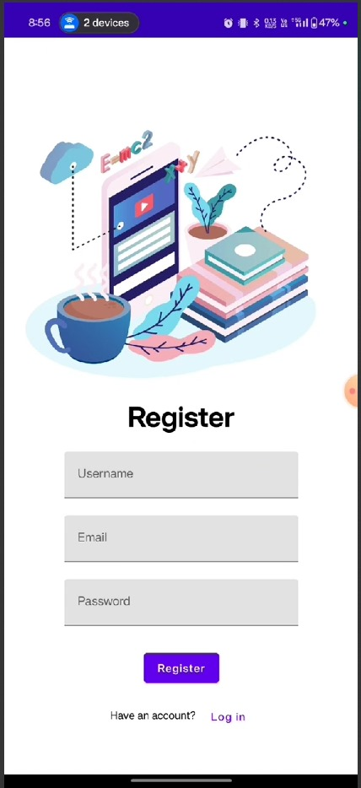
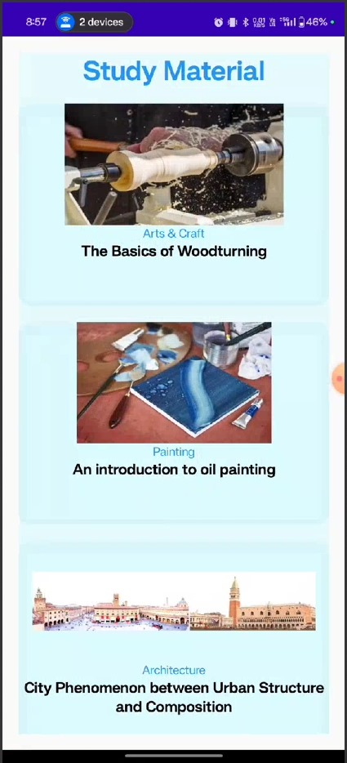
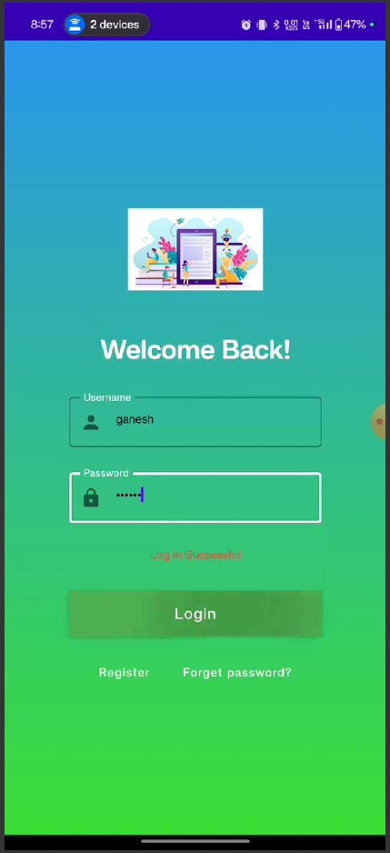
OUTPUT:

